Slide 1

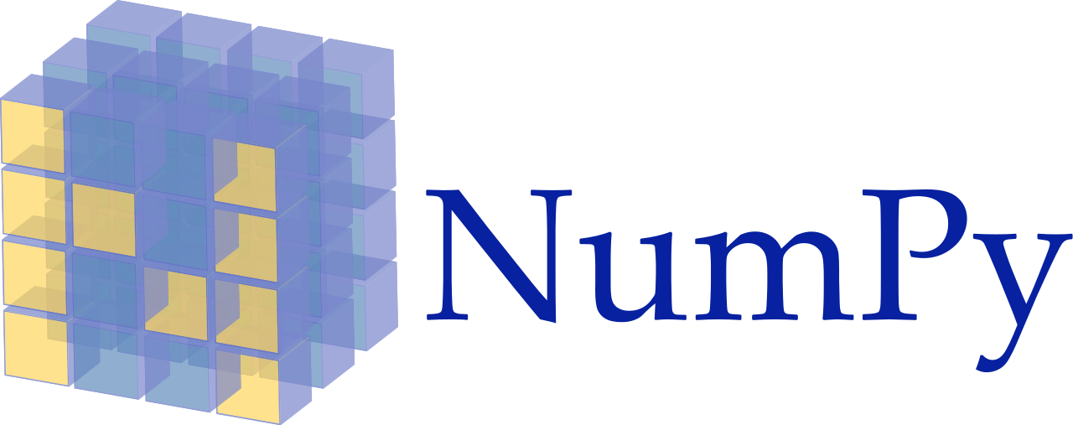

Slide 2
Outline
Universal functions
Indexing and slicing
Reshaping and transposing

Slide 3
Universal functions
NumPy offers dozens of standalone universal functions that perform various element-wise operations.
Some of these functions are called when you use operators like + and * on arrays.
The NumPy documentation lists universal functions in five categories—math, trigonometry, bit manipulation, comparison and floating point.
Math | add, subtract, multiply, divide, remainder, exp, log, sqrt, power, and more.
Trigonometry | sin, cos, tan, hypot, arcsin, arccos, arctan, and more.
Bit manipulation | bitwise_and, bitwise_or, bitwise_xor, invert, left_shift and right_shift.
Comparison | greater, greater_equal, less, less_equal, equal, not_equal, logical_and,logical_or, logical_xor, logical_not, minimum, maximum, and more.
Floating point | floor, ceil, isinf, isnan, fabs, trunc, and more.

Slide 4
Indexing and slicing
Array element can access by referring to its index number.
The indexes in NumPy arrays start with 0, meaning that the first element has index 0, then second element has index 1 etc.
axis = 1
axis = 1
axis = 2
0
1
2
2
3
4
Index
0
1
2
2
3
4
2
3
4
axis = 0
0
2
5
6
7
3
4
Value
2
3
4
axis = 0
1
5
6
7
5
6
7
5
8
9
10
6
7
8
9
10
8
9
10
2
8
9
10
1D array
2D array
3D array

Slide 5
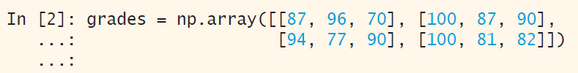
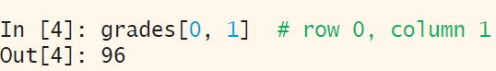
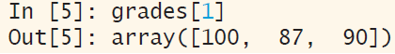
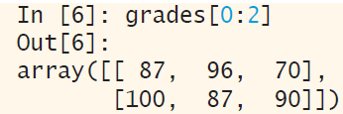
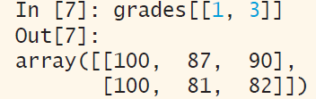
Indexing and slicing
Slicing step describes the spacing between two values and is optional [start:stop] with a default value of 1. Negative values are supported (e.g [::-1] reverses the order).

Slide 6
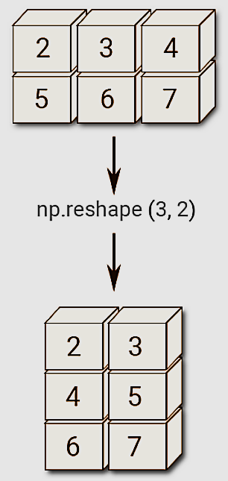


Reshaping and transposing
The reshape() function is used to give a new shape to an array without changing its data.

Slide 7
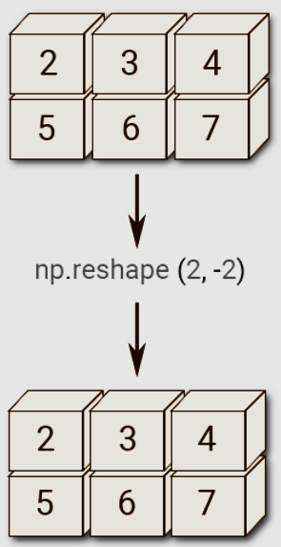


Reshaping and transposing

Slide 8
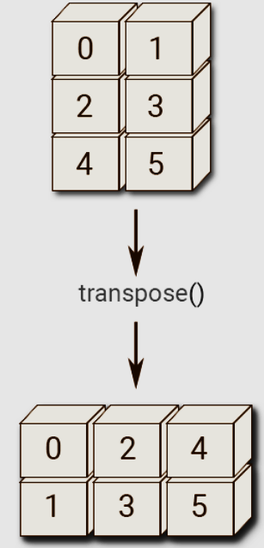


Reshaping and transposing
Transposing:
Returns the transpose of a matrix.
If the matrix shape is (X,Y), then transpose matrix shape will be (Y,X). It switches the row and column indices of a matrix.

Slide 9
End

